Slide 1

ES2015 / ES6
Basics of modern JavaScript

Slide 2
Agenda
Evolution of JavaScript
Main goals of JavaScript and ES6
ES6 in practice (selected features)
Q&A

Slide 3
Dictionary
•
JavaScript (JS) - a high-level, dynamic, untyped, and interpreted programming language created originally for web browsers, ECMAScript implementation
•
ECMA International - an international non-profit standards organization for information and communication systems.It acquired its current name in 1994, when the European Computer Manufacturers Association (ECMA) changed its name to reflect the organization's global reach and activities
•
ECMAScript (ES)- scripting-language specification standardized by Ecma International in ECMA-262 and ISO/IEC 16262. Well-known implementations of the language, such as JavaScript, JScript and ActionScript have come into wide use for client-side scripting on the Web
•
ES2015 (ES6) - the newest version of ECMAScript

Slide 4

90s
•
1995: Netscape creates Mocha
•
1995: Mocha -> LiveScript -> JavaScript
•
1996: ECMA adopts JavaScript
•
1997: ECMA-262 (ES1)
•
1998: ES2
•
1999: ES3 (regex, try/catch)

Slide 5




90s
•
browser wars IE vs Netscape
•
DHTML, “animate everything”
•
forms validation
•
visitor counters
•
code had to be optimised per browser (IE vs Netscape)

Slide 6

2000-2004
•
browser wars - IE wins
•
not much going on in JS world

Slide 7









2005: AJAX
•
Broadband Internet becomes popular
•
Asynchronus server requests (AJAX) becomes popular
•
renaissance of JavaScript
•
countless libraries (mainly helping with AJAX requests and DOM operations)

Slide 8

2006-2009
•
2008: ECMAScript4 (abandoned)
•
2009: ECMAScript 5 (strict, JSON, Reflect)
•
2009: servers welcome JavaScript: Node.js

Slide 9








2010-2015
•
frameworks evolution, no longer just DOM & AJAX helpers
•
JS packet managers: npm, bower
•
solutions for keeping code in modules (node.js, CommonJS, AMD, Browserify)
•
JavaScript preprocessors (Grunt, Gulp, Webpack,…)

Slide 10
Now
•
2015: ECMAScript 2015 (lots of features)
•
since 2015 a new ES spec will be released each year
•
upcoming: ES2016 (no major changes)

Slide 11






2016
Web browser
Server
Mobile Apps
Desktop Apps

Slide 12
JavaScript - pros
•
easy syntax
•
functions are objects (awesome!)
•
independent from any big company
•
the only native web browser language
•
big and vibrant community
•
lots of helpful tools, libraries and frameworks

Slide 13

JavaScript

Slide 14


JavaScript ≠ Java
≠
≠
Guinea pig ≠ pig

Slide 15
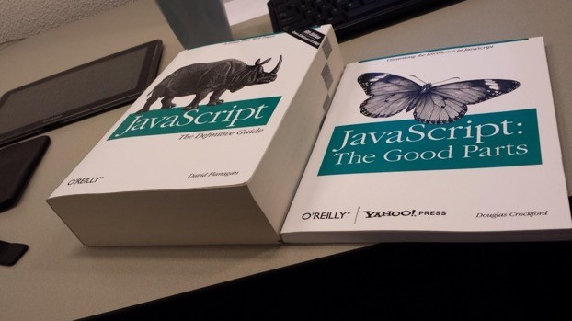
JavaScript - cons
(subjective list)
differences in comparison to Java-like languages can create confusion (prototypes vs classes,function scope vs block scope, hoisting, +,
…)
•

Slide 16
JavaScript - cons
(subjective list)
•
not many unequivocal clean code practices (each framework = new practices, enforcing bad practices can be harmful to community)
•
very rapid development often makes tools and frameworks obsolete fast, it is hard to choose frameworks and tools for apps that need to be maintained for years

Slide 17
Main goals of ES6
fix (some of) ES5 problems
backwards compatibility (ES5 code is valid in ES6)
modern syntax
better suited for big applications new features in standard library
•
•
•
•
•

Slide 18
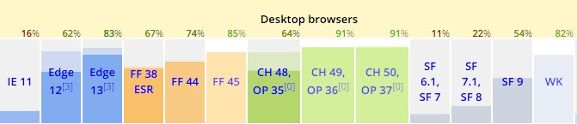
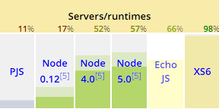
ES6 -today
kangax.github.io/compat-table
https://node.green/

Slide 19
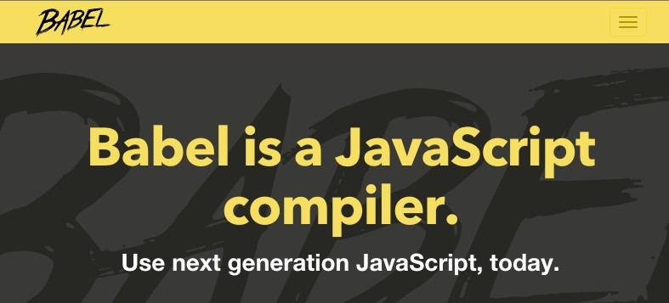
ES6 in browsers today
•
ES6 => ES5 transpilers

Slide 20
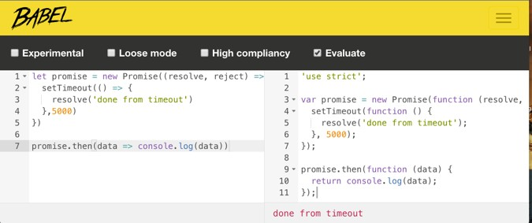
Babel - usage
command line:
$ babel es6.js -o es5.js
Online:
•
Konfigurator: http://babeljs.io/docs/setup/

Slide 21
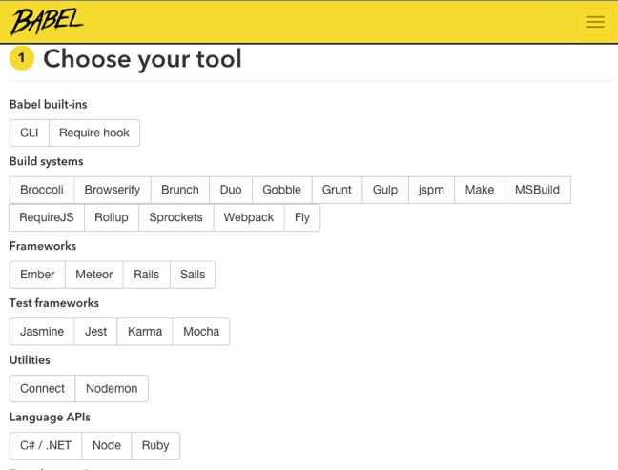
Babel - usage
•
Online wizard: https://babeljs.io/en/setup/

Slide 22

ES6 in practice

Slide 23
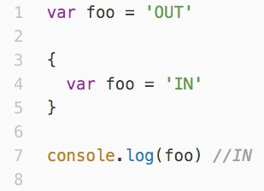
ES5: var

Slide 24
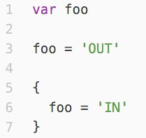
ES5: var - hoisting

Slide 25
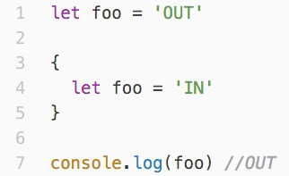
ES6: let is new var

Slide 26
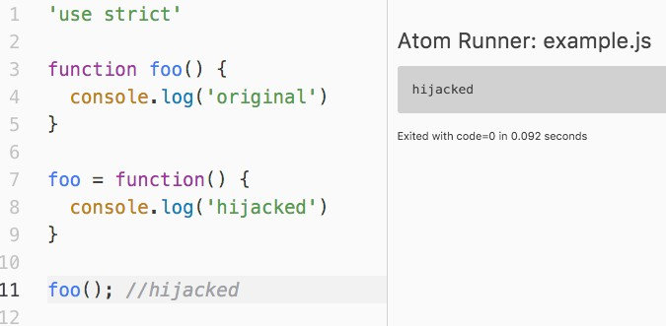
ES5…

Slide 27
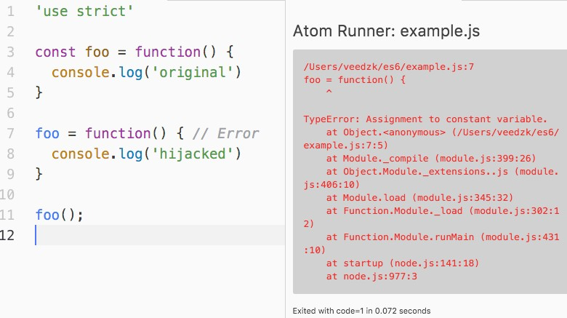
…ES6: const

Slide 28

ES5: concatenation

Slide 29
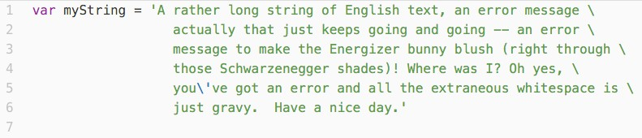
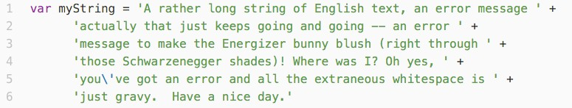
ES5: long strings

Slide 30
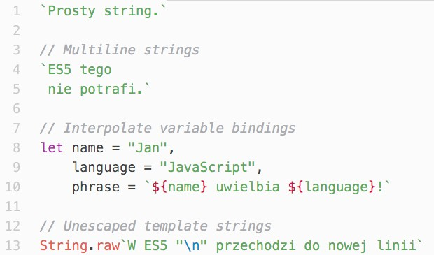
ES6: Template strings

Slide 31


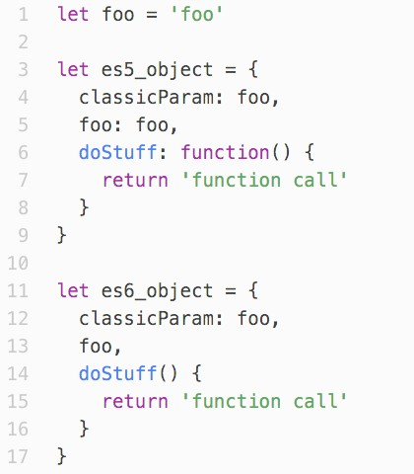





ES6: Object declarations

Slide 32
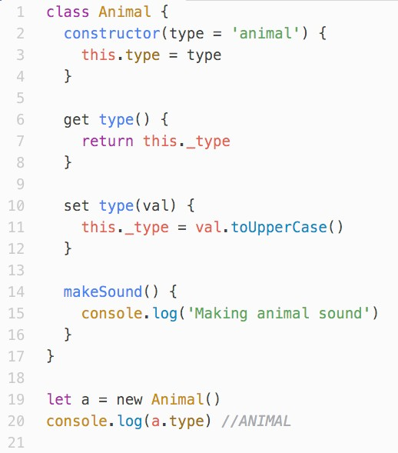
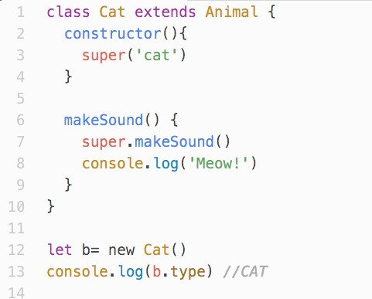
ES6: Classes

Slide 33
ES6: Classes

Slide 34








ES6: Setters & getters

Slide 35
ES6: Default params

Slide 36
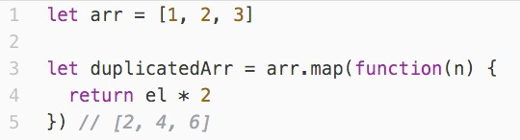
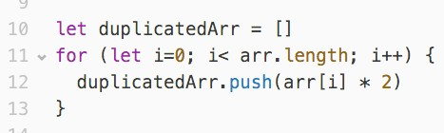
ES5 recap: map
el

Slide 37
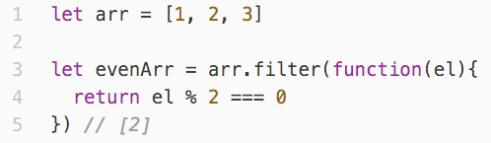
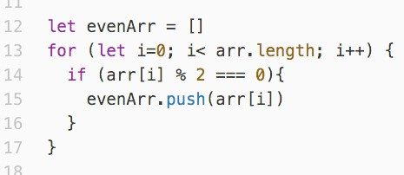
ES5 recap: filter

Slide 38
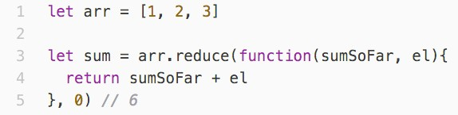
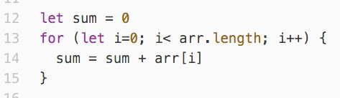
ES5 recap: reduce

Slide 39
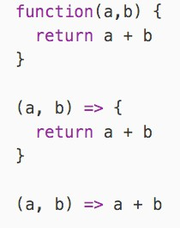
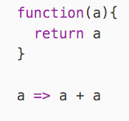
ES6: Arrow functions

Slide 40
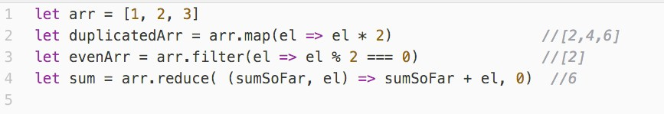
ES6: Arrow functions

Slide 41
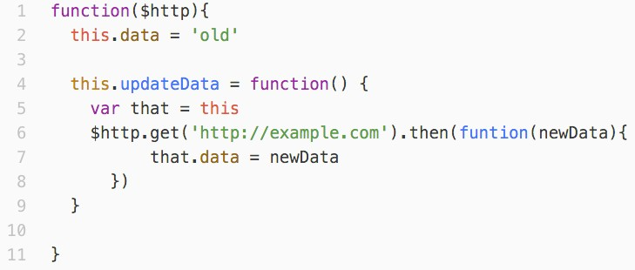
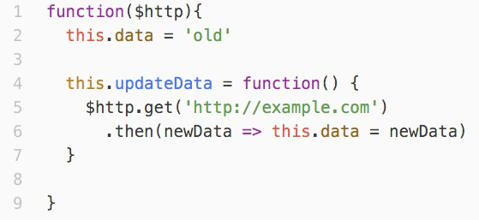
Arrow functions: this

Slide 42
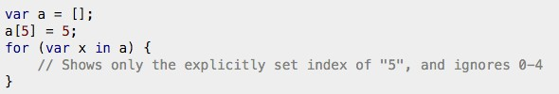
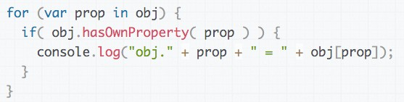
ES5: for … in
•
best practice: avoid that loop

Slide 43
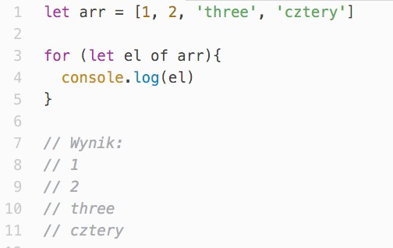
ES6: for … of
•
for … of can iterate not only over arrays
•
Homework: Iterators in ES6

Slide 44
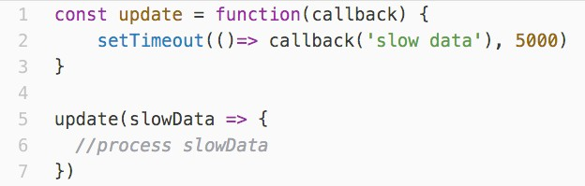
Asynchronus programming
•
common in JS (animations, server requests, etc.) Classic solution: callback
Problem: only one callback per async task
•
•

Slide 45
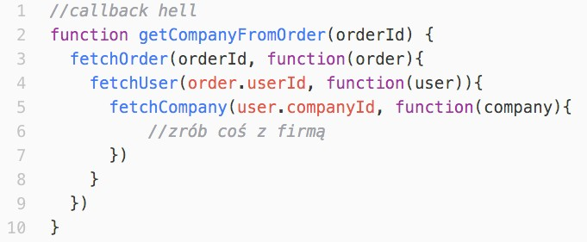
Async programming, ES5
•
Problem: Nested functions create messy code

Slide 46

Async programming, ES5
•
Second try: Listeners
Problem: no reaction when async function ends before listener registers, often hard to debug
•

Slide 47
ES6: Promise
•
object that keeps a result of an async function (waiting, resolved, rejected)
•
fixes earlier problem with listeners, since callback is called even if async function completed the task earlier
•
allows to return (Promise) objects and work with them, even if async function is still not completed (better code readability)
•
“promises” that it will get resolved
•
uses Observer pattern to populate the result
•
flattens nested promises to avoid “callback hell”

Slide 48














Promises
Promise
Listener 1
States: waiting
resolved rejected
•
•
•
Listener 2
Listener 3
async function

Slide 49
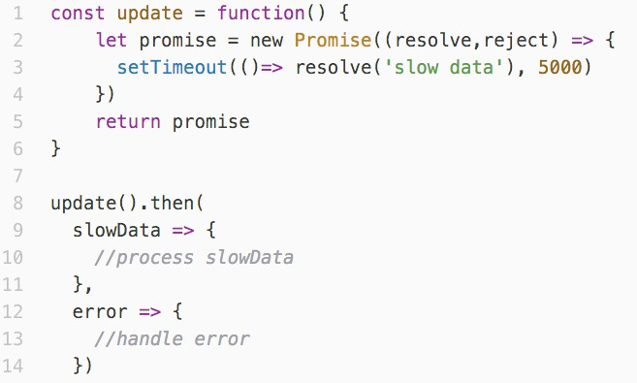
Promises

Slide 50
Callback hell, ES5

Slide 51
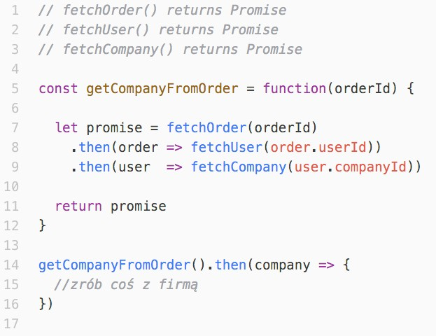
Promises

Slide 52
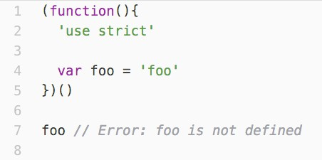
Modules (ES5)
•
IIFE (Immediately Invoked Function Expression)
•
controls variable exposure

Slide 53
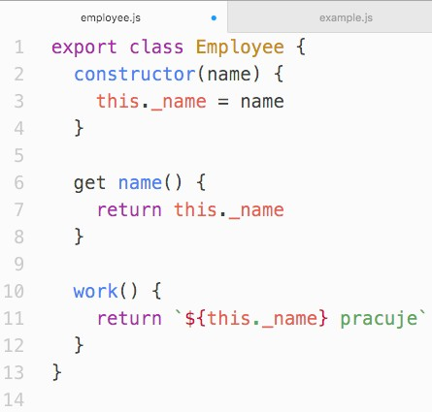
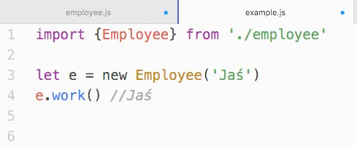
Modules (ES6) in browser
•
use tools such as Browserify / Webpack,
•
native ES6 modules are not yet implemented

Slide 54
What we have learned?
•
let/const
•
template strings
•
new ways to declare objects
•
classes
•
map, filter, reduce (ES5)
•
arrow functions
•
for … of
•
Promises
•
Modules

Slide 55
Other ES6 features
•
Proxy
•
Iterators
•
Generators
•
Symbols
•
Map/Set, WeakMap/WeakSet
•
extended standard library (Number, Math, Array)

Slide 56
Summary
•
use transpilers (Babel) to write ES6 today for any browser
•
learn ES6 step by step, you don’t have to know everything at once
•
many features are syntactic sugar, use with moderation
•
ES6 is now, go learn it!

Slide 57
What next?
•
Babel docs: https://babeljs.io/docs/learn-es2015/
•
Mozilla docs: http://developer.mozilla.org/en-US/ docs/Web/JavaScript
•
ES specs: https://github.com/tc39/ecma262
•
Pluralsight: JavaScript Fundamentals for ES6
•
Youtube: FunFunFunction

Slide 58
Q&A

